Slide 1
A Brief FROST Tutorial
Ayonga Hereid
University of Michigan

Slide 2
FROST Architecture
Goal: An integrated framework for modeling, simulation and optimization of dynamical systems
User
Matlab Core Framework
Backends
Dynamical System Model
Mathematica
Symbolic Engine
URDF
Symbolic Math Toolbox
Hybrid Dynamics (Locomotion)
Behavior Configuration
Continuous Dynamics
Discrete Dynamics
MEX
binaries
Controller
Physical Constraints
Visualization
System Simulation
Trajectory Optimization
NLP solvers
e.g., ipopt, fmincon, etc.

Slide 3
Outline
Symbolic Math Toolbox for Matlab
SymExpression
SymVariable
SymFunction
Dynamical System Model
Continuous Dynamics
Discrete Dynamics
Hybrid Dynamical System
Trajectory Optimization
Continuous Dynamics Trajectory Optimization
Hybrid Dynamics Trajectory Optimization

Slide 4
Symbolic Math Toolbox for MATLAB
Use Mathematica kernel as the backend
Can be use as native MATLAB data types (sym, numeric, etc.)
Easy to export symbolic expressions to C++ codes and compile as MEX binaries
Matlab
Mathlink
Mathematica
>> a = b + c; % b and c are symbolic variables
>> s = cos(a.^2) % ^ is for matrix
s =
Cos[(b + c)^2]
>> sfun = SymFunction(‘name’, s, {b,c});
>> export(sfun, path_to_export, options)
Compiling: name.cc Elapsed time is 1.888936 seconds.

Slide 5
Symbolic Math Toolbox for MATLAB
Three classes to define different types of symbolic expression objects:
Two main functions for evaluating Mathematica code:
eval_math(‘RandomReal[10]’)
eval_math_fun(‘RandomReal’,10)
SymExpression
SymVariable
SymFunction
a basic data type for symbolic expression (e.g., a and s)
a representation of symbolic variables (e.g., b and c)
a wrapper class for SymExpression with extra info (e.g., sfun)

Slide 6
How to create a SymExpression object
Basic Syntax:
var can be:
numerical data: e.g., eye(3)
cell: e.g., {{1,2},{1,2,3},{4}}
string: e.g., “symbol”
a structure data: e.g., var.a = [1,2]; var.b = ‘prop’;
Mathematica expression as a character vector: ‘a+b’
Other SymExpression objects
Extra options:
This option will delay the evaluation of symbolic expression var until we evaluate the value the object s
Useful for creating complicated symbolic expression, e.g., Coriolis vector
>> s = SymExpression(var);
>> s = SymExpression(var, ‘DelayedSet’, true);

Slide 7
How to use SymExpression Objects?
Simply treated it as native data types (almost similar to sym):
mathematical operators:
+, -, *, /, ^, etc.
mathematical function:
sqrt, cos, sin, atan, exp, etc.
concatenate:
vertical
horizontal
reference via index:
assign via index:
>> (a + b).^2
>> sin(x)*cos(x)
>> [a; b]
>> [a, b]
>> c = a([1,2],3:end)
>> a(1,2) = s

Slide 8
Other Handy Functionalities
Symbolic derivatives:
Substitute symbolic variables:
Convert to numeric values:
>> s = cos((b + c).^2) ;
>> jacobian(s, b)
ans =
{{-2*(b + c)*Sin[(b + c)^2]}}
>> subs(s, {b,c}, {pi,0})
ans =
-0.9026853608240101
>> double(s)
ans =
-0.9026853608240101

Slide 9
SymVariable Class
Used to represent Mathematica symbolic variables as a Matlab object
Scalar variable:
Variable array (2-D):
>> a = SymVariable(‘a’)
ans =
a
>> a = SymVariable(‘a’,[3,1])
ans =
{{a$1$1, a$1$2, a$1$3}}
(optional) Label the variables:
Reference using labels:
>> a = SymVariable(‘a’,[3,1],{‘alpha’,’beta’,’gamma’});
>> a(‘beta’) + a(‘gamma’)
ans =
{a$2$1+a$3$1}

Slide 10
SymFunction Class
A wrapper class for SymExpression objects with extra information
Extra properties:
Name: the (file) name of the function to be exported
Vars: the dependent variables of the expression
Params: the constant parameters of the expression
Syntax:
Additional functions:
export: exports as “name.cc” file, with syntax name(var1,var2,…,param1,param2,…)
exportJacobian:
exports the Jacobian w.r.t. “Vars”, with name “J_name.cc”
also export the sparsity pattern of the Jacobian matrix, with name “Js_name.cc”
exportHessian:
export the Hessian w.r.t. “Vars”, with name “H_name.cc”
also exports the sparsity pattern of the Hessian matrix, with name “Hs_name.cc”
*All “final” symbolic expressions are converted and stored as SymFunction objects.
>> sfun = SymFunction(‘name’, s, {b}, {c});

Slide 11
Dynamical System Models
Class Hierarchy:
Basic System Configuration:
Name: the identification
Type: first- or second-order system
System Variables:
State variables:
Input variables:
control inputs
external forces (disturbance, etc.)
constraint wrenches (holonomic constraints, etc.)
Parameters:
Dynamical
System
Abstract
superclass
Continuous
Dynamics
Discrete
Dynamics
RobotLinks
RigidImpact

Slide 12
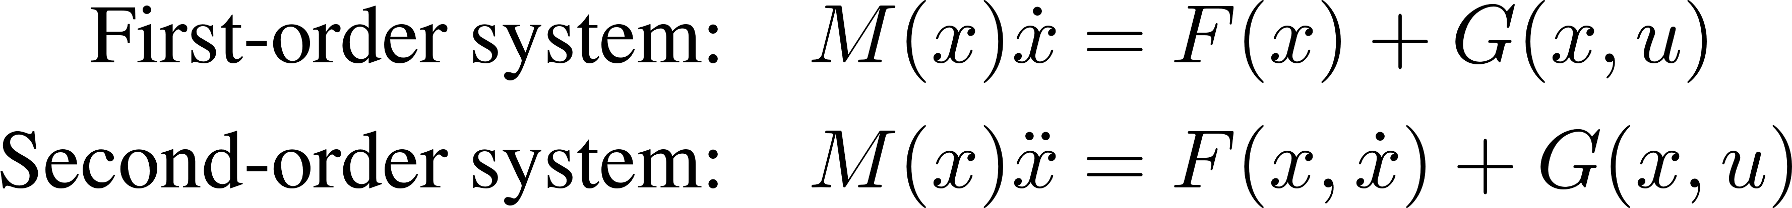
Continuous Dynamics
We consider a general form for continuous dynamics:
M(x) : the mass matrix
F(x) : the collection of the drift vectors
G(x,u) : the collection of the input vectors
create
sys = ContinuousDynamics(‘FirstOrder’, ‘foo’);
add variables
sys.addState(x,dx);
sys.addInput(‘Control’, ‘u’, u, G, ‘Affine’, true);
sys.addParam(‘p’, p);
set dynamics
sys.setMassMatrix(Mmat);
sys.setDriftVector(Fvec);
extra constraints
holnomic constraints
unilateral constraints
virtual constraints

Slide 13
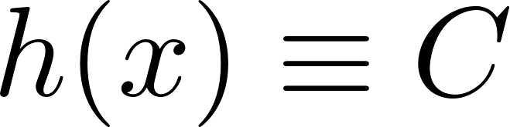
Holonomic Constraints:
Holonomic Constraints are defined using the class HolonomicConstraint
Construct a holonomic constraint object:
Add/remove a holonomic constraint object to the system
sys.addHolonomicConstraint(hol)
sys.removeHolonomicConstraint(‘name’)
Adding a holonomic constraint will also automatically add:
an affine constraint wrench variable with name ‘fname’
a parameter variable of the constant value of the holonomic constraint with name ‘pname’
hol = HolonomicConstraint(sys, expr, ‘name’,…
‘ConstrLabel’, labels,… % optional
‘Jacobian’, jac,… % optional
‘DerivativeOrder’, 2); % default 2
sys: the system model
expr: the constraint expression
name: the name of the constraint
Holonomic constraints are automatically added in the optimization.

Slide 14
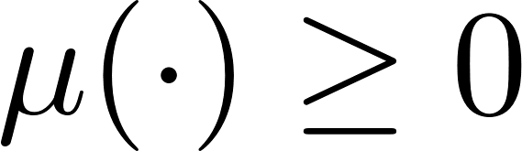
Unilateral Constraints
Constraints are defined using class UnilateralConstraint
Construct an unilateral constraint object:
Add/remove a unilateral constraint object to the system
sys.addUnilateralConstraint(cstr)
sys.removeUnilateralConstraint(‘name’)
Unilateral constraints do NOT affect the simulation, only being imposed as path constraints for the optimization
cstr = UnilateralConstraint(sys, expr, ‘name’, deps, …
‘ConstrLabel’, labels,… % optional
‘AuxData’, auxdata); % optional
sys: the system model
expr: the constraint expression
name: the name of the constraint
deps: the dependent variables
Unilateral constraints are automatically added in the optimization.

Slide 15
Unilateral Constraint as Event Function
Unilateral constraints can be used as event functions to terminate the simulation
Add/remove event functions:
sys.addEvent(cstr)
sys.removeEvent(‘eventname’)
To activate an event function in simulation:
*make sure to specify the event name when calling the simulate function
sol = sys.simulate(t0, x0, tf, controller, params, logger, ‘eventname’, options, solver);

Slide 16

Controller Classes
Controller classes are separated from the system classes
Each controller classes must be inherited from the superclass ‘Controller’
Must have a method function with syntax:
Existing controllers based on virtual constraints:
control.calcControl(t, x, vfc, gfc, plant, params, logger)
Controller
IOFeedback*
CLFQP
OutputPD
JointPD
*Grizzle et al., TAC 2001 & TAC 2003

Slide 17
Virtual Constraints
Virtual constraints are defined using the class VirtualConstraint
Syntax:
Optional arguments (always use Name-Value pairs):
DesiredType: ‘Bezier’, ‘Constant’, ‘CWF’, etc.
PolyDegree: the degree of the desired polynomial, e.g., 5
RelativeDegree: the relative degree of the virtual constraint, e.g., 2
PhaseType: ‘StateBased’ or ‘TimeBased’
PhaseVariable: a symbolic expression of the phase variable if it is ‘StateBased’, e.g., (x(1)-p(1)/p(2)-p(1))
PhaseParams: a set of parameters used to describe the phase variable, e.g., p
Holonomic: true for holonomic constraints, false for non-holonomic constraints
sys: the system model
ya: the actual output expression
name: the name of the constraint
vc = VirtualConstraint(sys, ya, ‘name’, options);

Slide 18
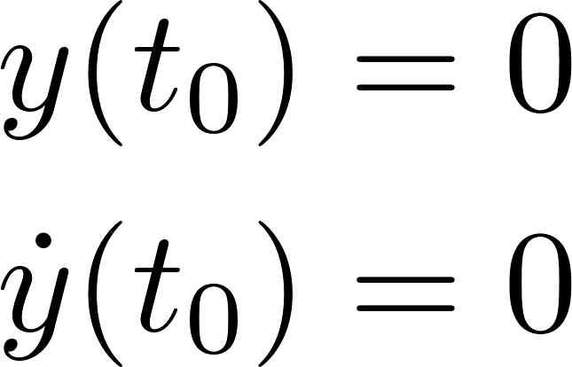
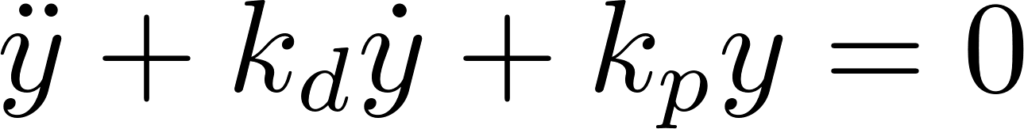
Virtual Constraints
Add/remove a virtual constraint object to the system
sys.addVirtualConstraint(vc)
sys.removeVirtualConstraint(‘name’)
Adding a virtual constraint will also add:
a set of parameter variables for the desired output with the name ‘aname’
(optional) a set of phase variable parameters with the name ‘pname’
Virtual constraints will NOT be automatically imposed as constraints in the optimization
to add them in the optimization, invoke imposeNlpConstraint function manually.
For example, assume we have a relative degree 2 virtual holonomic constraint vc:
nlp = vc.imposeNlpConstraint(nlp, [kp,kd], [1,1]);

Slide 19
An example of Continuous Dynamics: RobotLinks
The class RobotLinks represents a tree structure of rigid bodies
Construct a RobotLinks object from an URDF file
base: the settings of the base coordinates, could be one of the followings
‘floating’: 6-dimensional floating base coordinates
‘planar’: 3-dimensional planar base
‘revolute’: 1-dimensional revolute joint
‘prismatic’: 1-dimensional prismatic joint
‘fixed’: fixed base, no coordinates
The followings will be automatically configured when constructing a RobotLinks object:
state variables
control input variables
robot kinematics
fixed joints as holonomic constraints
Dynamics can be configures manually with a simple method call:
robot.configureDynamics();
robot = RobotLinks(‘cassie.urdf’, base);

Slide 20
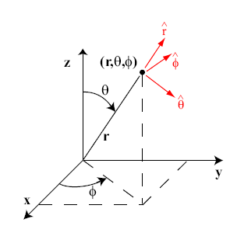
Robot Kinematics
Name: the frame name
Reference: the reference frame
Offset: the offset of the origin in the reference
R: the rotation matrix from the reference
CoordinateFrame
RigidJoint
RigidBody
ContactFrame
Type
Axis
Child
Parent
Limit
Mass
Inertia
Type
*always assume z-axis is normal to the contact surface
For each coordinate frame object, you can compute:
Cartesian position of a point on the frame (with offset given)
Euler angle of the coordinate frame w.r.t. the world frame
6-Dimensional body jacobian
6-Dimensional spatial jacobian

Slide 21
Robot Kinematics Examples
Assume frame be the end-effector frame of a robot manipulator object robot
pos = getCartesianPosition(robot, frame); % return symbolic expressions for % 3x1 Cartesian position
ang = getEulerAngles(robot, frame); % return symbolic expressions for % (roll,pitch,yaw) rotation angles
jac = getBodyJacobian(robot, frame); % return symbolic expressions for % 6xN body Jacobian matrix
jac = getSpatialJacobian(robot, frame); % return symbolic expressions for % 6xN body Jacobian matrix

Slide 22
Contact Model
Contact Types:
Add contacts to a robot model:
optional argument determines associated unilateral constraints (friction cone, ZMP):
fric: the friction coefficient
geom: the geometry of the contact
Adding a contact will also add:
a holonomic constraints
two (optional) unilateral constraints
friction cone
normal force
translational friction
torsional friction
Zero moment point
rotating around the edges
robot.addContact(contact, fric, geom);

Slide 23
Discrete Dynamics and Rigid Impact
By default, the discrete dynamics is an identity map.
A discrete dynamics always associates with a discrete event of the continuous dynamics.
RigidImpact is a subclass of DiscreteDynamics.
You can set the constraints for the rigid impact using HolonomicConstraint objects
dsys = DiscreteDynamics(‘SecondOrder’, ‘name’, ‘eventname’)
impact = RigidImpact( ‘name’, robot, ‘eventname’);
impact.addImpactConstraint(imp_cstr);

Slide 24
Hybrid System Model
A hybrid system is represented by a directed graph (see digraph of MATLAB)
A directed graph consists of:
Nodes: represents a continuous domain
Domain: the continuous dynamical system model
Controller: the controller (input-output feedback linearization controller by default)
Params: a set of model and controller parameters
Edges: represents a discrete jump
Guard: the discrete dynamical system model
Params: a set of parameters
Weights: maybe useful for future?
A simple directed cycle
A directed acyclic graph
more general directed graph
isDirectedCycle
isdag

Slide 25
Hybrid System Model
First construct a empty HybridSystem object:
sys = HybridSystem(‘sys_name’, options);
Add a vertex:
Remove a vertex:
Add an edge:
Remove an edge:
sys.addVertex(‘domain_name’);
sys.addEdge(‘src_domain’, ‘tar_domain’);
sys.rmVertex(‘domain_name’);
sys.rmEdge(‘src_domain’, ‘tar_domain’);
Vertex/edge properties can be either set when we add them, or set them afterward:
sys.setVertexProperties(‘domain_name’, ‘Domain’, domain, ‘Controller’, control);
sys.setEdgeProperties(‘src_domain’, ‘tar_domain’, ‘Guard’, guard);

Slide 26
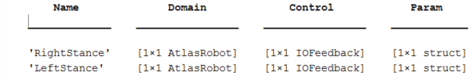
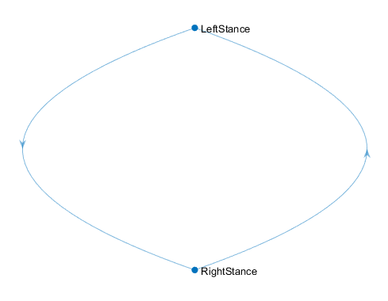
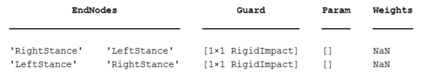
Example: Two-Domain Flat-Footed Walking Model
>> sys.Gamma.Nodes:
>> sys.Gamma.Edges:
>> plot(sys.Gamma)

Slide 27
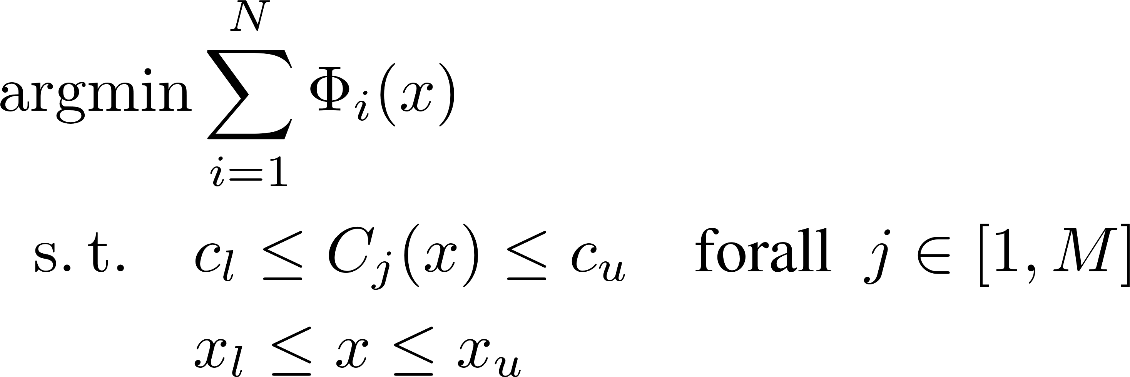
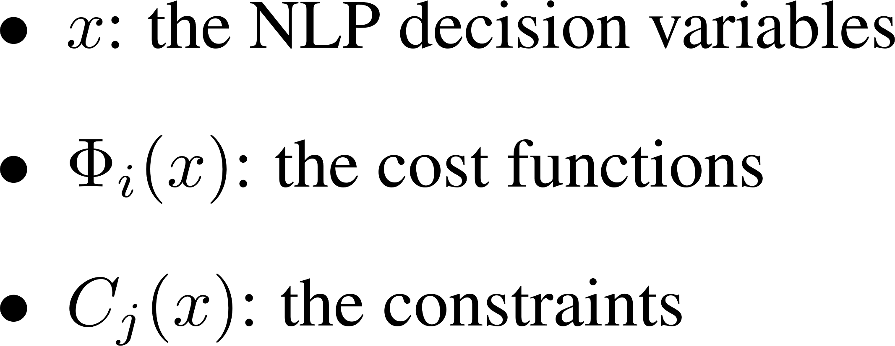
Basis: Nonlinear Programming (NLP) Problem
A general nonlinear programming problem:
where
A NonlinearProgram object has three main components:
VariableArray:
An array of NlpVariable objects represents the list of NLP decision variables
ConstrArray:
An array of NlpFunction objects represents the list of NLP constraints
CostArray:
An array of NlpFunction objects represents the list of NLP cost functions

Slide 28
Basis: NlpVariable Class
A structured data type to store the information of NLP variables
Syntax:
Name-Value pairs (the order does not matter):
Structure:
Once added to the VariableArray, these variables will be indexed and store the indices within the object.
lb, ub, x0: can be updated after an object is constructed
v = NlpVariable(‘Name’,name, ‘Dimension’, dim,…
‘lb’, lb, ‘ub’, ub, ‘x0’, x0);
v = NlpVariable(v_struct);

Slide 29
Basis: NlpFunction Class
A structured data type to store the information of NLP functions, including cost and constraints
Syntax (Name-Value pairs or structure data)
Name-Value pairs (the order does not matter)
More often, a NlpFunction object will be associated with a SymFunction object
function expression, Jacobian, Hessian, etc.
the name of the function files
dimension
A NlpFunction object can also be the sum of multiple NlpFunction objects
The summand NlpFunction objects will be defined as the Summand properties of the main NlpFunction object
f = NlpFunction(‘Name’,name, ‘Dimension’, dim, ‘DepVariables’, deps, ‘AuxData’, aux,…
‘lb’, lb, ‘ub’, ub, ‘x0’, x0, ‘Type’, ‘Nonlinear’);

Slide 30
Basis: Nonlinear Programming (NLP) Problem
Class Hierarchy:
Nonlinear Program
Trajectory
Optimization
Continuous
Dynamics
Hybrid Trajectory Optimization
Hybrid Dynamics

Slide 31
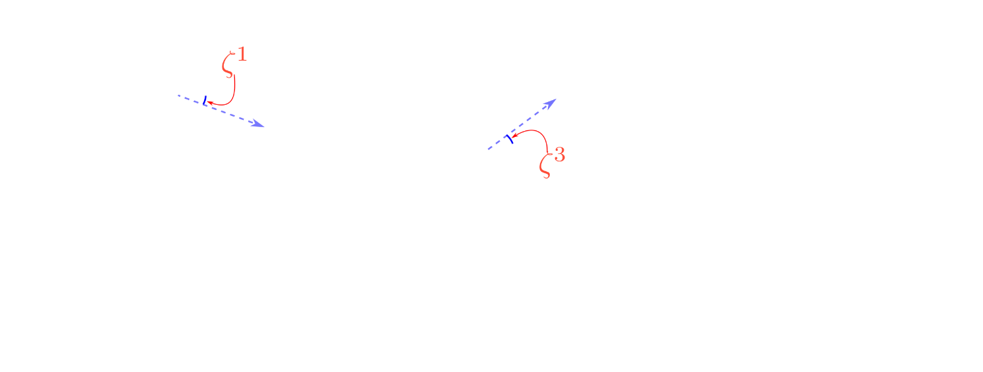

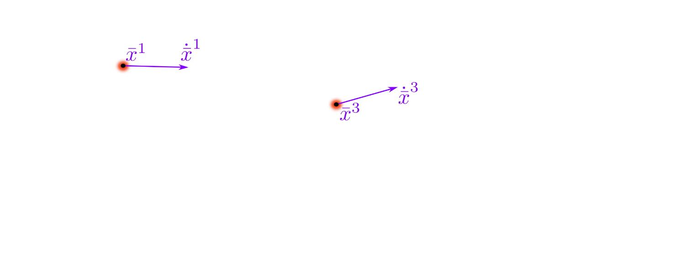
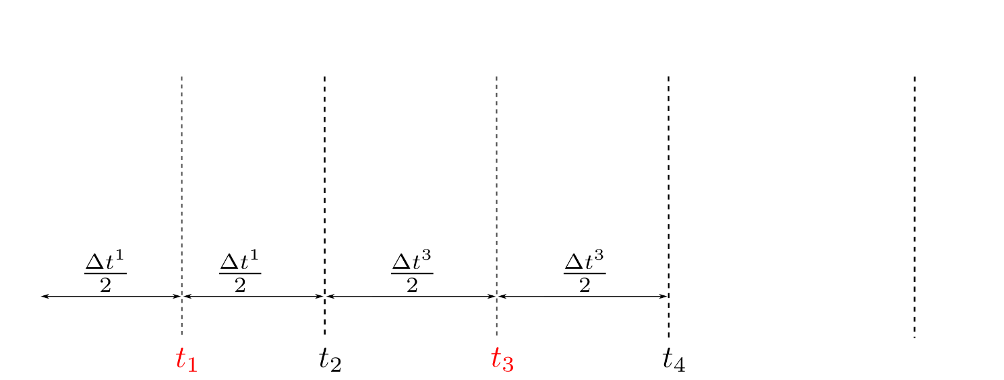
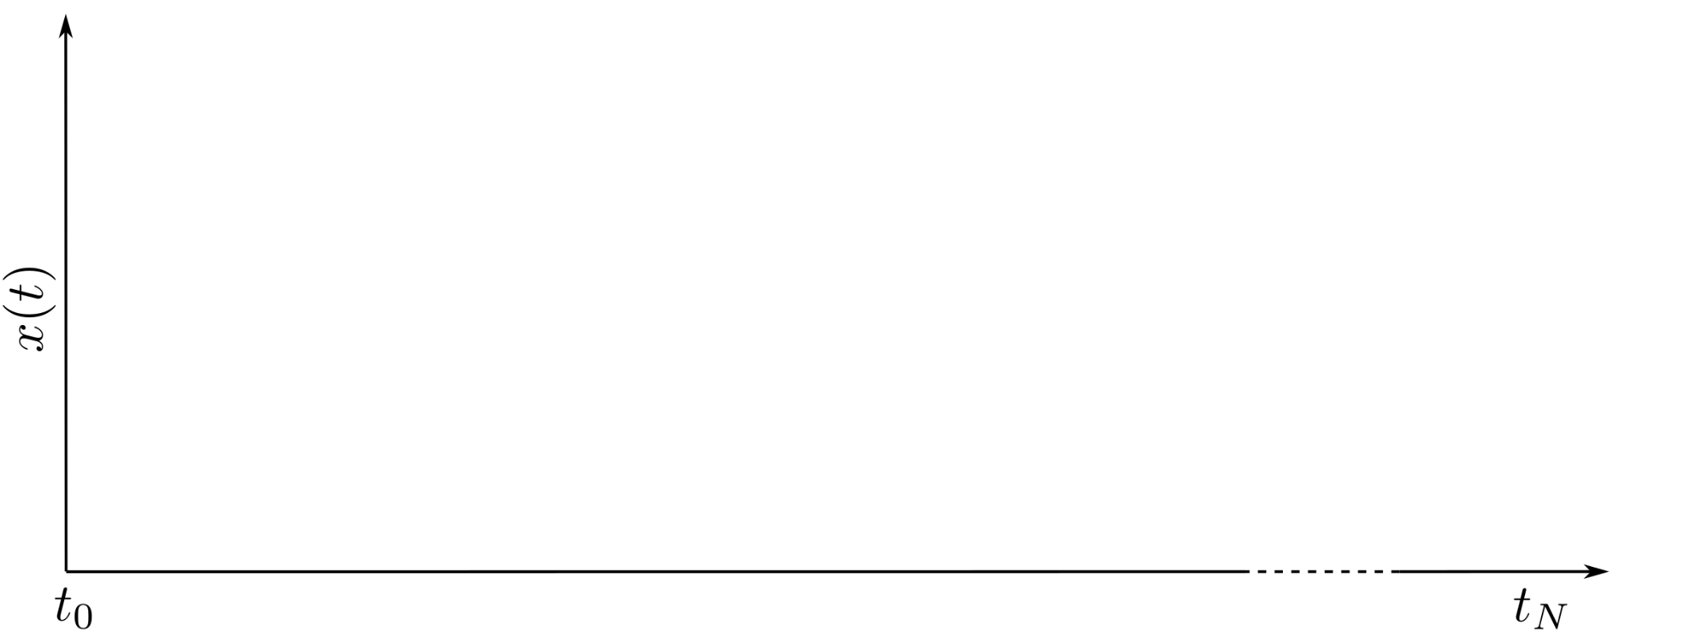
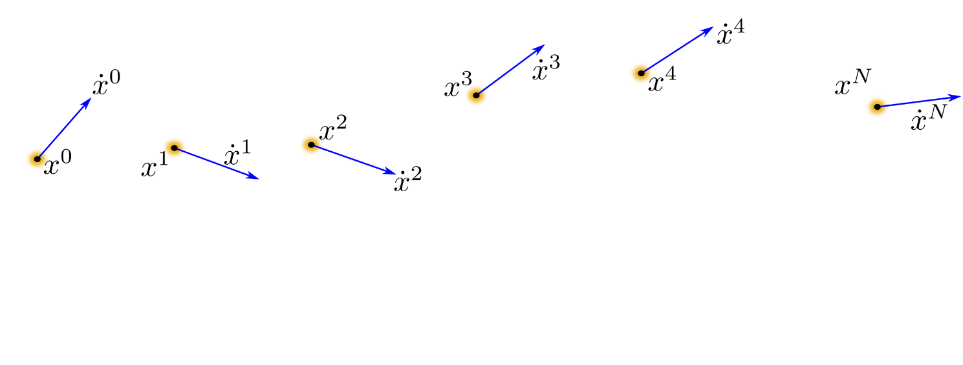
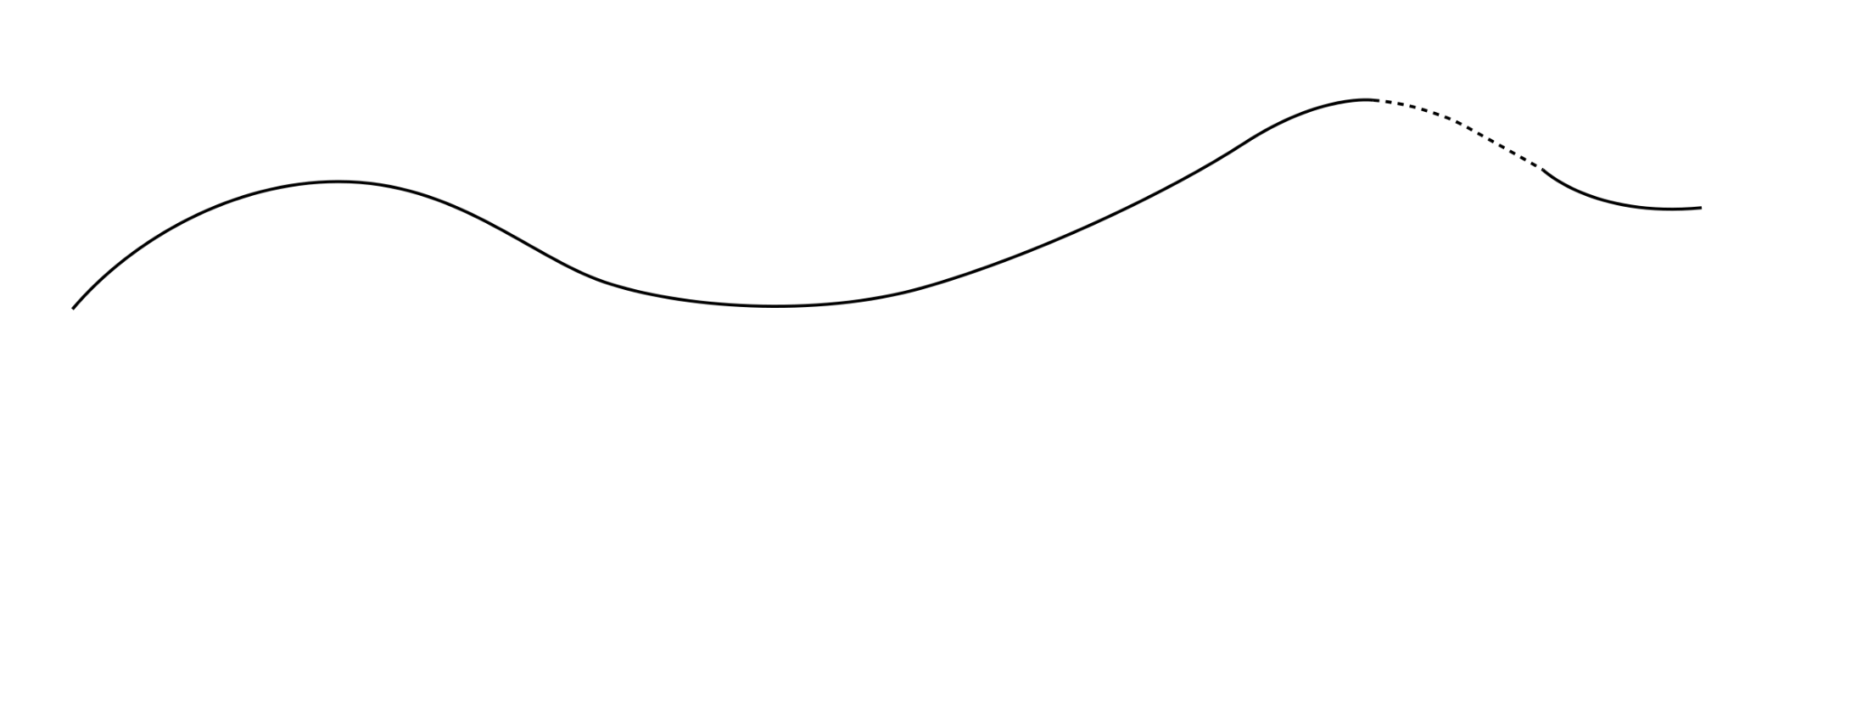
Trajectory Optimization Problem for Continuous Dynamics
Given a fully-defined ContinuousDynamics object and boundary conditions, we automatically construct a TrajectoryOptimization object for the model
The following three direct collocation schemes are supported:
HermiteSimpson
Trapzoidal
PseudoSpectral
Variables and functions are stored in 2D tables:
OptVarTable
ConstrTable
CostTable

Slide 32
Trajectory Optimization Problem for Continuous Dynamics
Construct a TrajectoryOptimization object is easy:
If num_grid is not given, use default value (10)
If bounds is given when creating the object, the problem will be automatically configured.
Otherwise, call nlp.configure(bounds) after the object is created.
nlp = TrajectoryOptimization(‘name’, sys, num_grid, bounds);
time variables
state variables
input variables
parameter variables
collocation constraints
dynamic constraints
holonomic constraints
unilateral constraints
user NLP constraints
Add Variable
Add Constraints
NLP configuration process

Slide 33
How to Customize Variables?
Add additional variables:
label: the name of the variable in the table
e.g., nlp.OptVarTable.T, nlp.OptVarTable.x
nodes: the location of the node at which the variable is defined
keywords: ‘first’, ‘last’, ‘all’, ‘except-first’, ‘except-last’, ‘except-terminal’, ‘interior’, ‘cardinal’
numbers
var: the structure that can be used to create a NlpVariable object
Remove existing variables
nlp.addVariable(‘label’, nodes, var);
nlp.removeVariable(‘label’); % removes from all nodes

Slide 34
How to Customize Constraints?
The easy way: add constraints that specifically defined on particular nodes
func: a SymFunction object for the constraint
deps: the name of dependent variables
nodes: the location of nodes at which the constraint is defined
lb: lower bound
ub: upper bound
type: linear or nonlinear
auxdata: auxiliary constant data
*All dependent variables must be defined at the same node
Remove existing constraints
nlp.addNodeConstraint(func, deps, nodes, lb, ub, type, auxdata);
nlp.removeConstraint (‘label’); % removes from all nodes

Slide 35
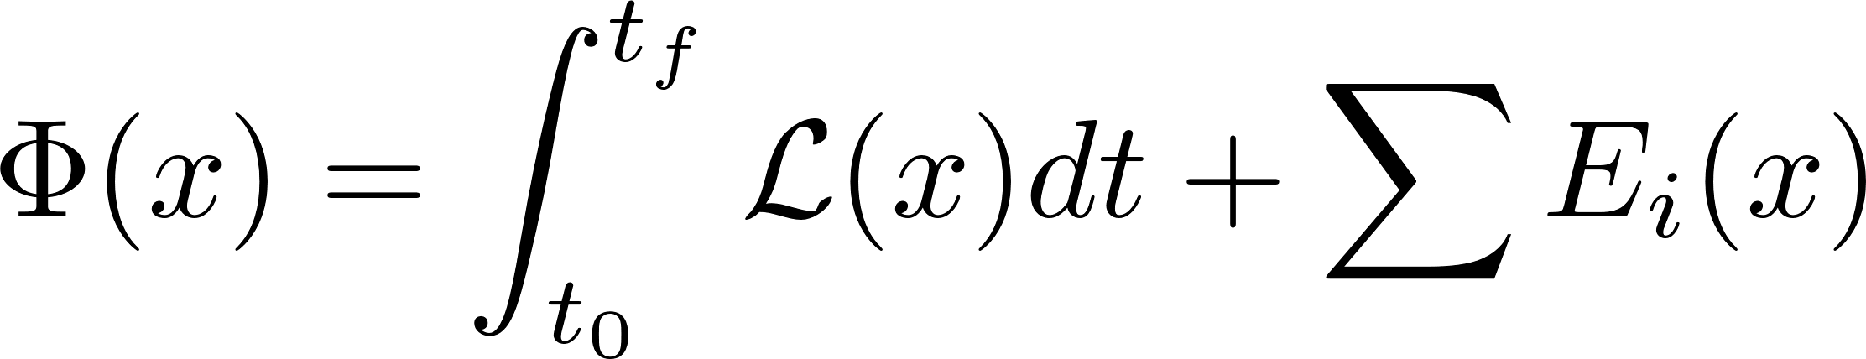
Add Cost Function
Cost function:
Two types of cost function:
Running cost: integrates over time
Terminal cost: evaluates only at the terminals => Node cost: evaluates only at particular nodes
Running cost:
Node cost:
*All dependent variables must be defined at the same node
Remove existing cost functions
nlp.addRunningCost(func, deps, auxdata);
nlp.addNodeCost(func, deps, nodes, auxdata);
nlp.removeCost(‘label’); % removes from all nodes

Slide 36
If dependent variables are not defined at the same node?
Create the NlpFunction object before add constraints or cost functions
Add constraints:
cstr_array: pre-created NlpFunction array for the constraint
Add cost functions:
cost_array: pre-created NlpFunction array for the cost
nlp.addConstraint(‘label’, nodes, cstr_array);
nlp.addConstraint(‘label’, nodes, cost_array);

Slide 37
Some Extra Suggestions
When to add/remove custom constraints?
Path constraints: define as unilateral constraints of the system
Callback function:
define a Matlab function in which all custom constraints are added
assign the function handle of this function to the property ‘UserNlpConstraint’ of the system object
*This function will be called during the configuration process
Add after the configuration process is completed
Update properties of variables and functions after the NLP problem is created:
updateConstrProp: lower/upper bound, SymFunction, auxiliary data
updateCostProp: SymFunction, auxiliary data
updateVariableProp: lower/upper bound, initial values

Slide 38
After NLP Problem is Created
Compile symbolic functions as MEX binaries
Link to a NLP solver
nlp.compileConstraint(‘constr’, path_to_export, ‘exclude_constrs’);
nlp.compileObjective (‘cost’, path_to_export, ‘exclude_costs’);
solver = IpoptApplication(nlp);
NLP
Ipopt
Application
Fmincon
Application
Snopt
Application
sol = solver.optimize(x0);

Slide 39
After the Optimization
Check violation
Export the solution
nlp.checkConstraints(sol, tol, output_file);
nlp.checkVariables(sol, tol, output_file);
nlp.checkCosts (sol, output_file);
[tspan, states, inputs, params] = nlp.exportSolution(sol);

Slide 40
Hybrid Trajectory Optimization
Only supports hybrid system model of which each node has only one successor!
Converts nodes and edges into an array of phases.
Each phase is a TrajectoryOptimization problem.
For edge phase, there is only one node and no integration!
Jump Constraints: impose the continuity of the time and states
nlp = HybridTrajectoryOptimization(‘name’, sys, num_grid, bounds);
Right
Stance
Jump
Left
Impact
Jump
Left
Stance
Jump
Right
Impact

Slide 41
After NLP Problem is Created
Compile symbolic functions as MEX binaries
Link to a NLP solver
nlp.compileConstraint(phase, ‘constr’, path_to_export, ‘exclude’);
nlp.compileObjective (phase, ‘cost’, path_to_export, ‘exclude’);
solver = SolverApplication(nlp);
NLP
Ipopt
Application
Fmincon
Application
Snopt
Application
sol = solver.optimize(x0);

Slide 42
After the Optimization
Check violation
Export the solution
nlp.checkConstraints(sol, tol, output_file);
nlp.checkVariables(sol, tol, output_file);
nlp.checkCosts (sol, output_file);
[tspan, states, inputs, params] = nlp.exportSolution(sol);

